Slide 1
Transportation Engineering Department (TED)
Zephyrhills Economic Summit December 11, 2024
Notes:
Vision: To be Florida’s Premier County
Mission: To Serve Our Community to Create a Better Future

Slide 2
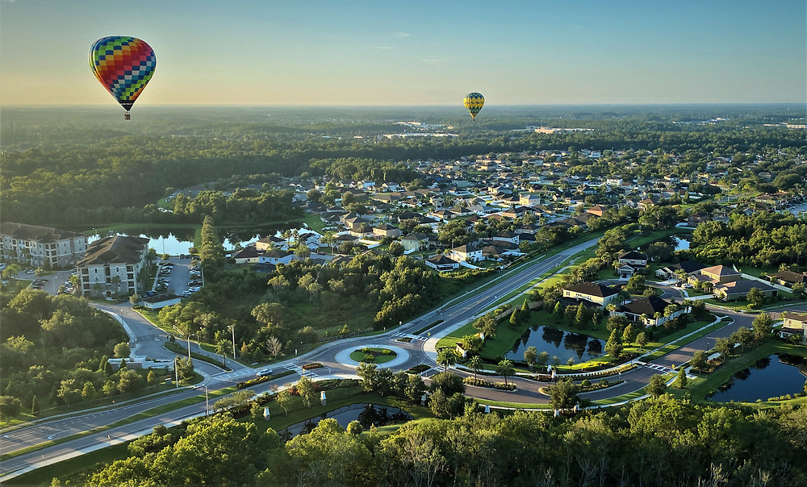
TED’s Purpose: Plan, design, build, operate, and maintain a safe, connected, and efficient multimodal transportation system for all users

Slide 3
The Funding
~$75M/yr
5¢ Local Gas Tax
Sales Tax – 40% of 45% of 1%
Property Taxes – 60% of 22% TIF
Developer Mobility Fees
~$55M/yr*
Federal Gas Tax
State Gas Tax
*Projects typ. built by FDOT
~$55 M/yr
State Gas Tax
State Doc Stamps
Veh Reg Fees
Tolls

Slide 4
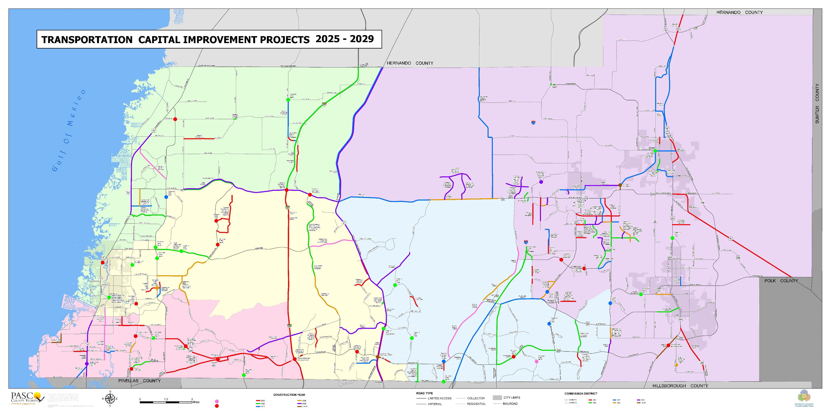

Slide 5
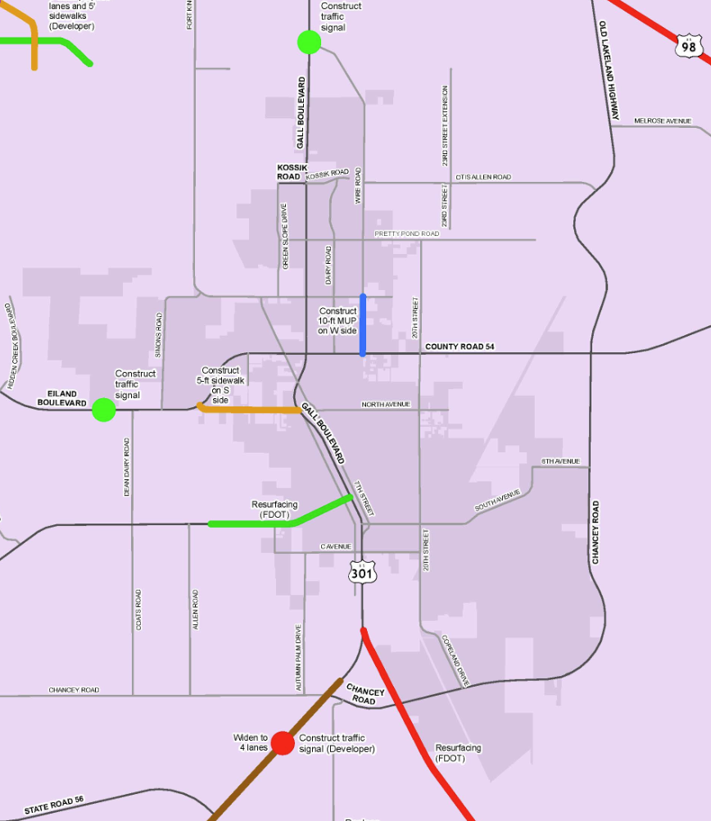
Transportation
Capital
Improvement
Projects
2025 - 2029

Slide 6
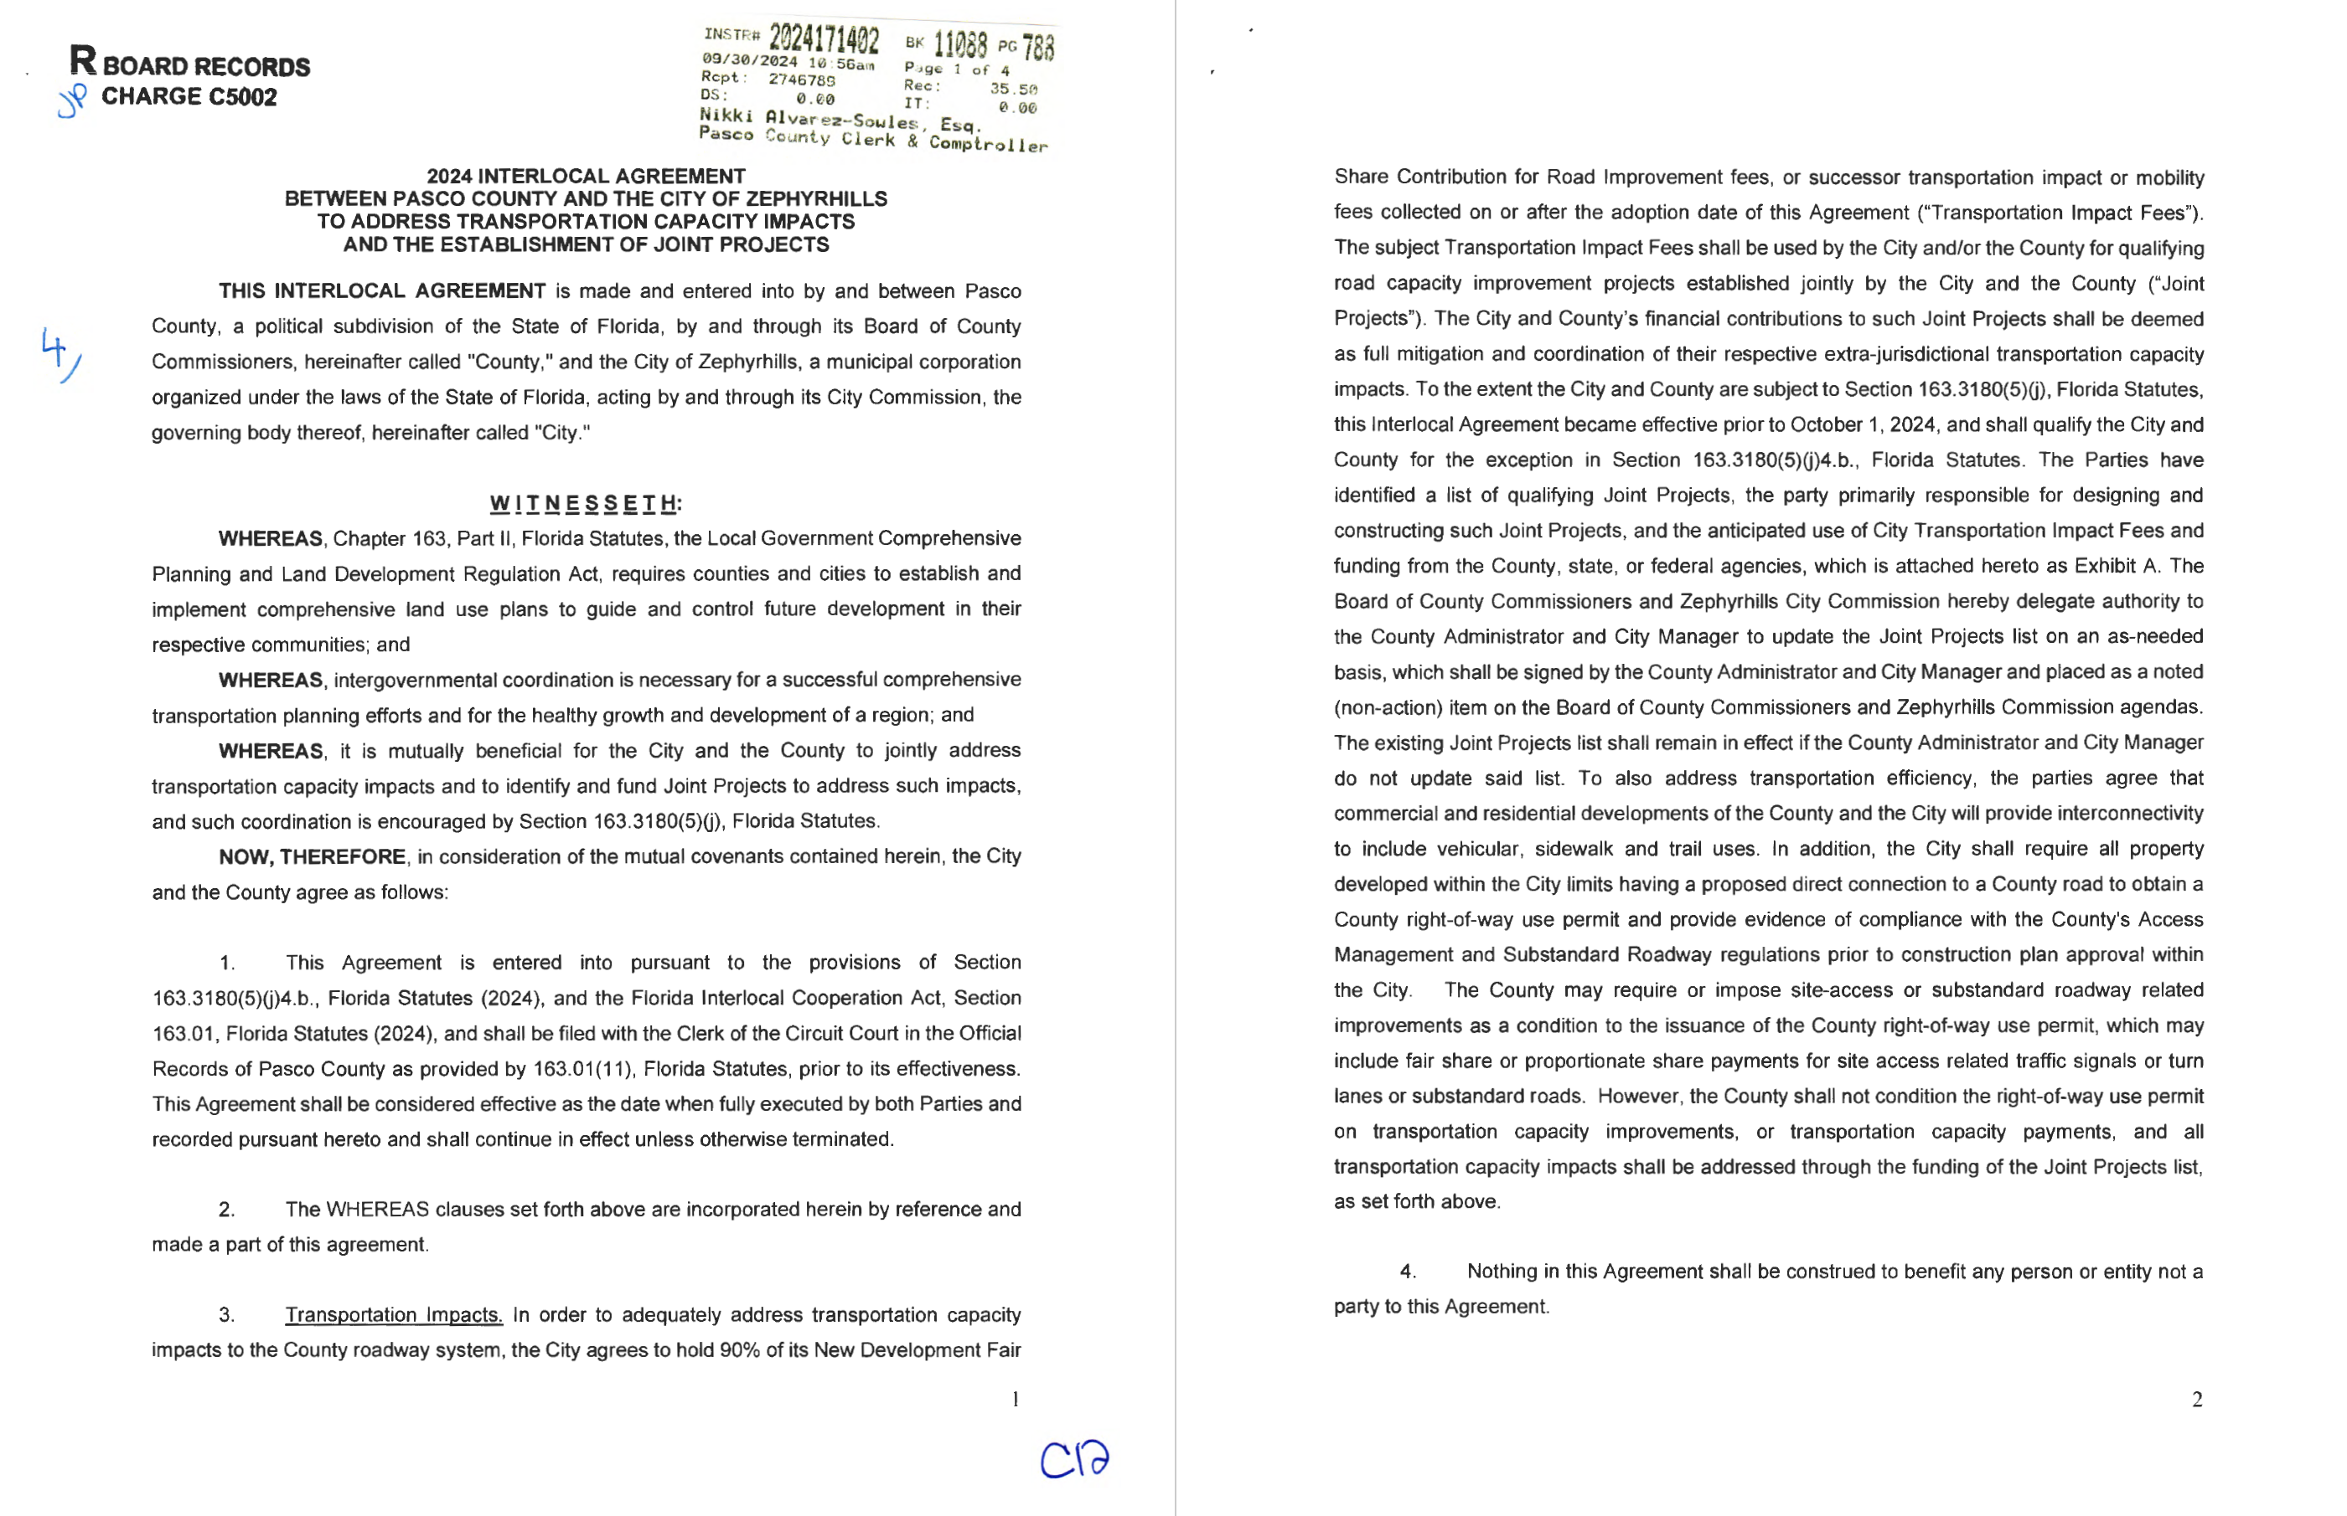
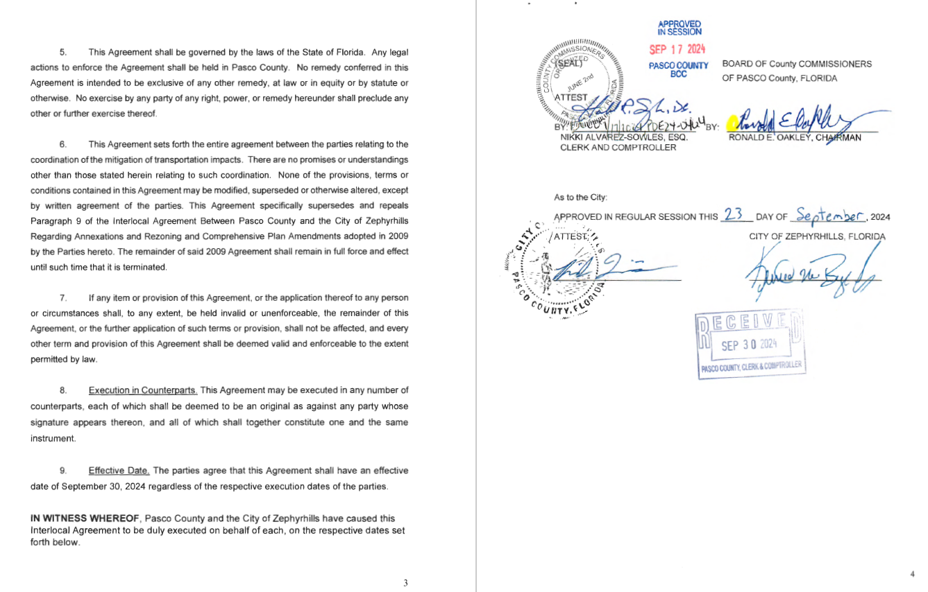

Slide 7
We can update the Joint Projects list on an as-needed basis

Slide 8
Questions?
Nick Uhren, County Engineer
nuhren@mypasco.net
(727) 834-3714

Slide 9
Key Content:
Funding sources and amounts (copy slide from Leadership Pasco?)
Highlight 2024 interlocal agreement w/ ZH – coordination of projects
ILA saved here: G:\DevSvcs Documents\TED\ADMINISTRATION\Budget\Mobility Fees\Zephyrhills ILA
Try showing two pages full screen and then zooming in on project selection sentence using animation.
Map of Zephyrhills area with capital projects shown (screen shot from Tracy O’s CIP map)
Contact info on final slide

